Slide 1

Chapter 13
Introduction to the Transport
Layer
Copyright © The McGraw-Hill Companies, Inc. Permission required for reproduction or display.

Slide 2
OBJECTIVES:
To define process-to-process communication at the transport layer and compare it with host-to-host communication at the network layer.
To discuss the addressing mechanism at the transport layer, to discuss port numbers, and to define the range of port numbers used for different purposes.
To explain the packetizing issue at the transport layer: encapsulation and decapsulation of messages.
To discuss multiplexing (many-to-one) and demultiplexing (one-to-many) services provided by the transport layer.
To discuss flow control and how it can be achieved at the transport layer.

Slide 3
OBJECTIVES (continued):
To discuss error control and how it can be achieved at the transport layer.
To discuss congestion control and how it can be achieved at the transport layer.
To discuss the connectionless and connection-oriented services at the transport layer and show their implementation using an FSM.
To discuss the behavior of four generic transport-layer protocols and their applications: simple protocol, Stop-and-Wait protocol, Go-Back-N protocol, and Selective-Repeat protocol.
To describe the idea of bidirectional communication at the transport layer using the piggybacking method.

Slide 4
Chapter
Outline
13.1 Transport-Layer Services
13.2 Transport-Layer Protocols

Slide 5
13-1 TRANSPORT-LAYER SERVICES
As we discussed in Chapter 2, the transport layer is located between the network layer and the application layer. The transport layer is responsible for providing services to the application layer; it receives services from the network layer. In this section, we discuss the services that can be provided by a transport layer; in the next section, we discuss the principle beyond several transport layer protocols.

Slide 6
Topics Discussed in the Section
Process-to-Process Communication
Addressing: Port Numbers
Encapsulation and Decapsulation
Multiplexing and Demultiplexing
Flow Control
Error Control
Congestion Control
Connectionless and Connection-Oriented Services

Slide 7
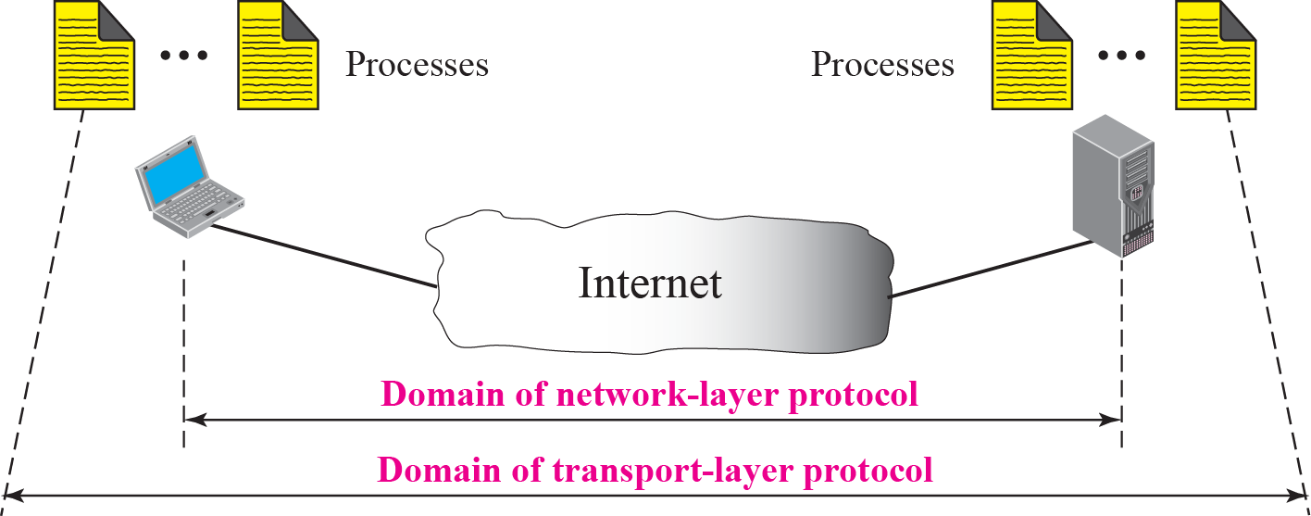
Figure 13.1 Network layer versus transport layer

Slide 8
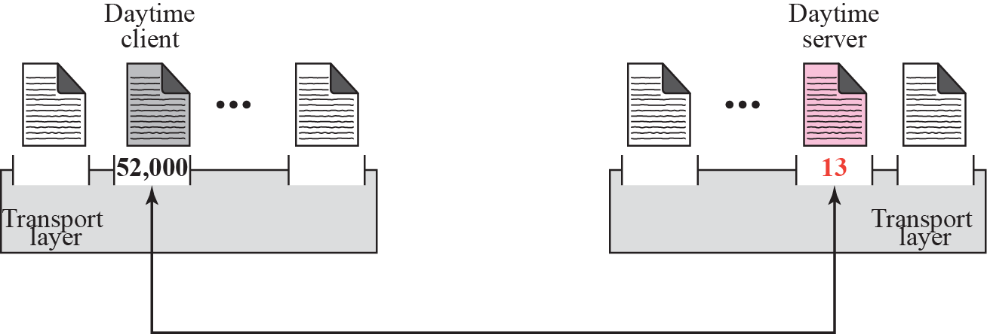
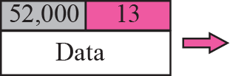
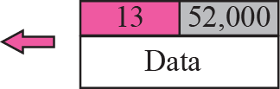
Figure 13.2 Port numbers

Slide 9
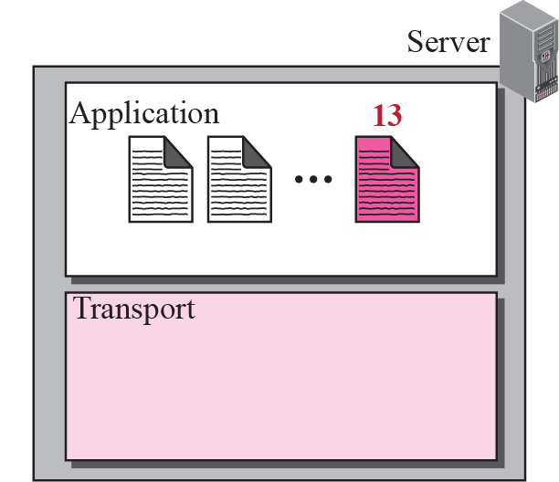
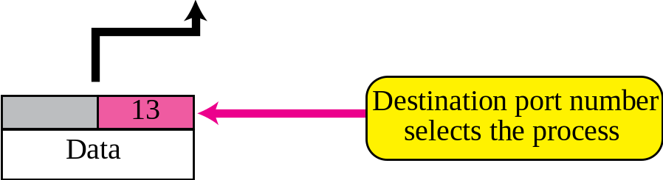
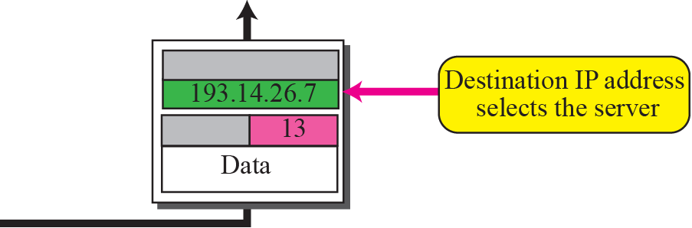
Figure 13.3 IP addresses versus port numbers

Slide 10
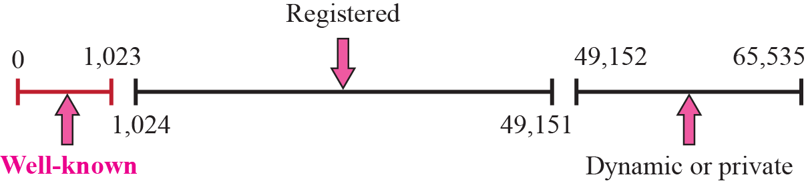
Figure 13.4 ICANN ranges

Slide 11

Note
The well-known port numbers are
less than 1,024.

Slide 12
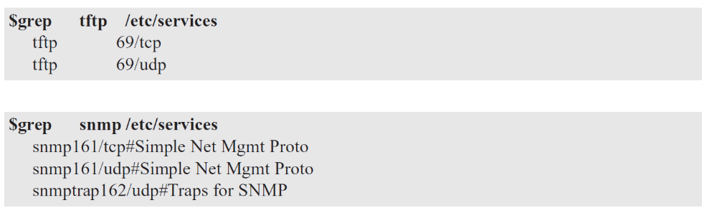
Example 13.1
In UNIX, the well-known ports are stored in a file called /etc/services. Each line in this file gives the name of the server and the well-known port number. We can use the grep utility to extract the line corresponding to the desired application. The following shows the port for TFTP. Note that TFTP can use port 69 on either UDP or TCP. SNMP (see Chapter 24) uses two port numbers (161 and 162), each for a different purpose.

Slide 13
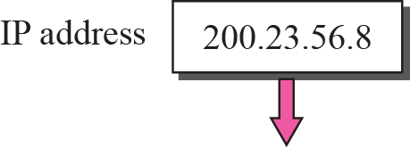
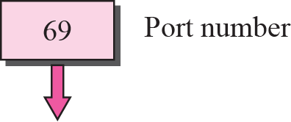

Figure 13.5 Socket address

Slide 14
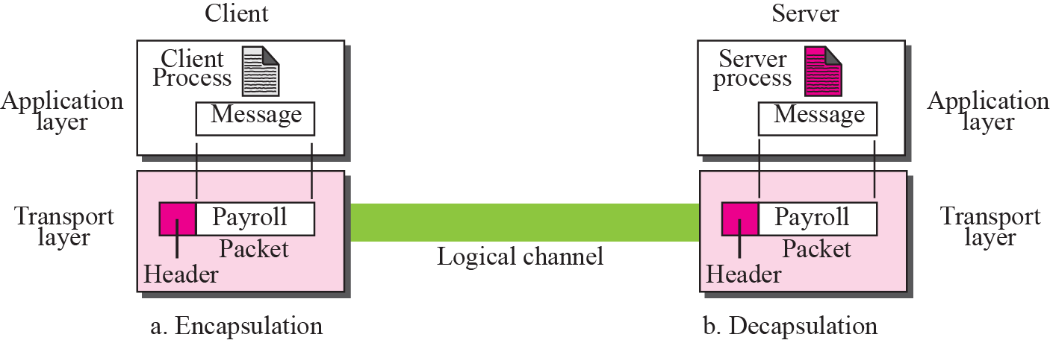
Figure 13.6 Encapsulation and decapsulation

Slide 15
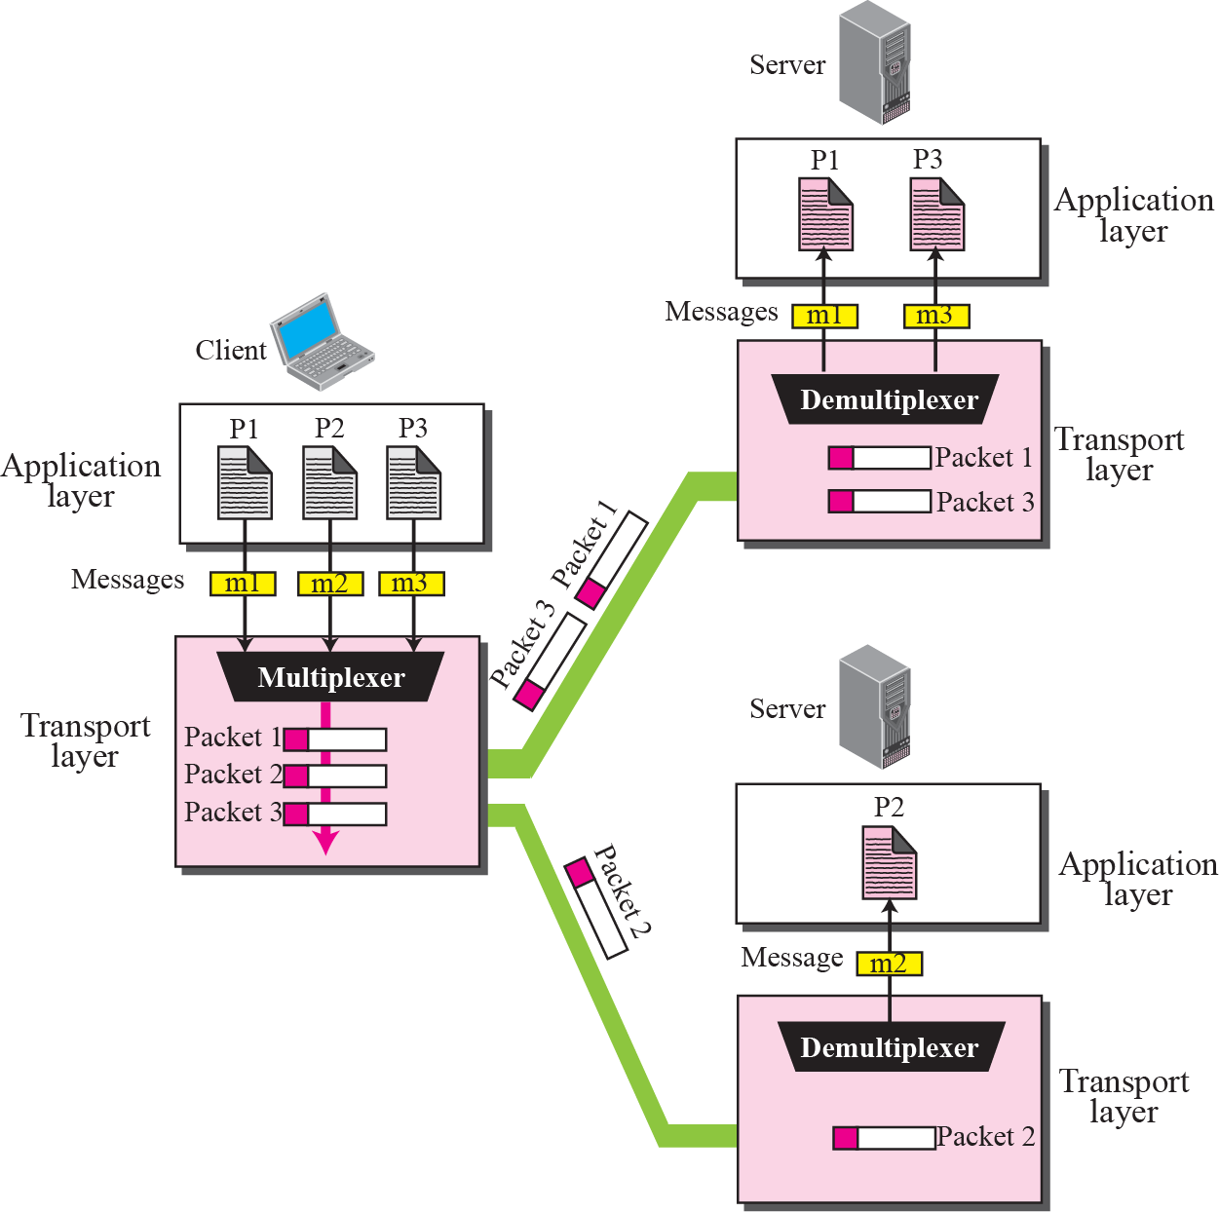
Figure 13.7 Multiplexing and demultiplexing

Slide 16
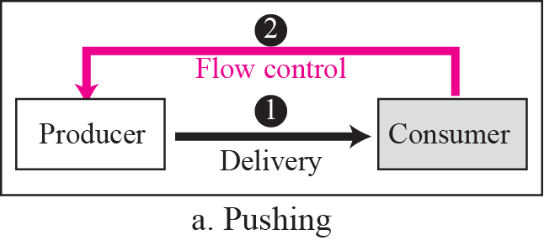
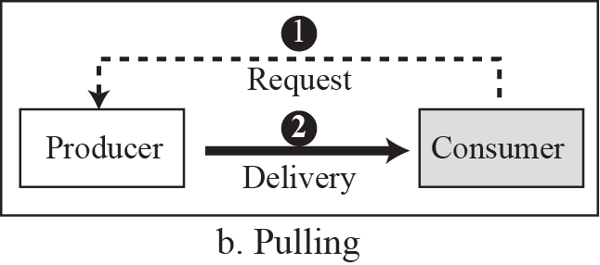
Figure 13.8 Pushing or pulling

Slide 17
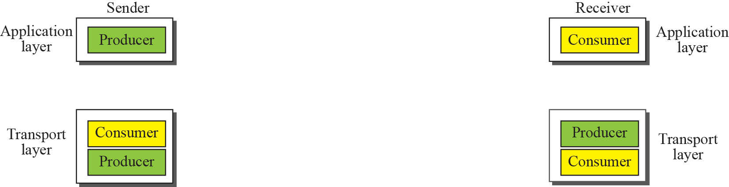
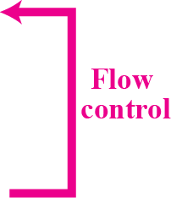
Figure 13.9 Flow control at the transport layer

Slide 18
Example 13.2
The above discussion requires that the consumers communicate with the producers in two occasions: when the buffer is full and when there are vacancies. If the two parties use a buffer of only one slot, the communication can be easier. Assume that each transport layer uses one single memory location to hold a packet. When this single slot in the sending transport layer is empty, the sending transport layer sends a note to the application layer to send its next chunk; when this single slot in the receiving transport layer is empty, it sends an acknowledgment to the sending transport layer to send its next packet. As we will see later, this type of flow control, using a single-slot buffer at the sender and the receiver, is inefficient.

Slide 19
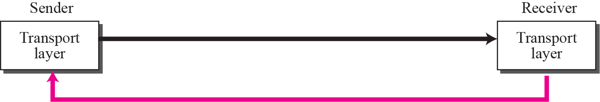
Figure 13.10 Error control at the transport layer
Packets
Error Control

Slide 20
Note
For error control, the sequence numbers are modulo 2^{m}, where m is the size of the sequence number field in bits.

Slide 21
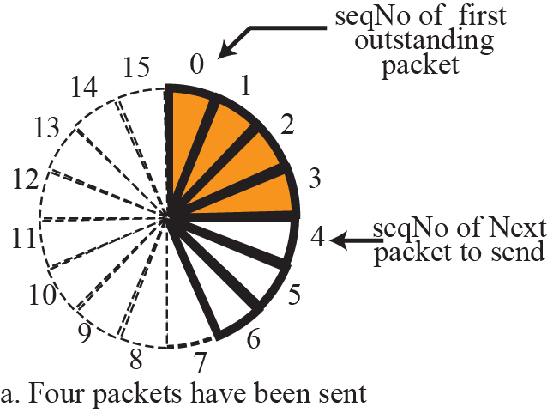
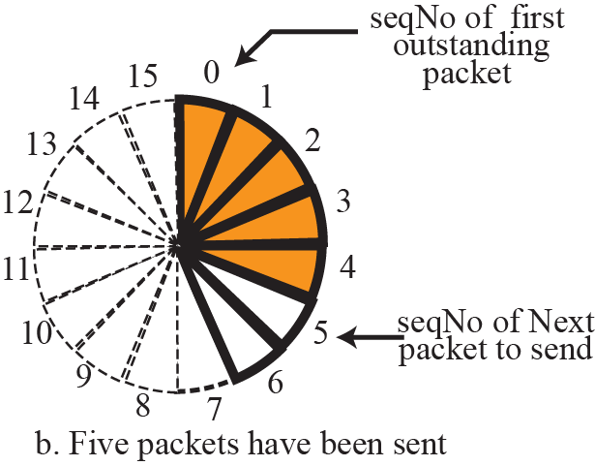
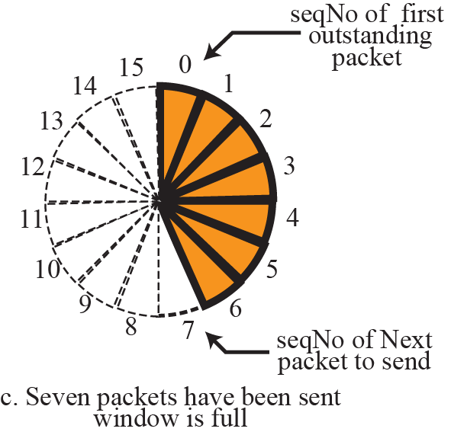
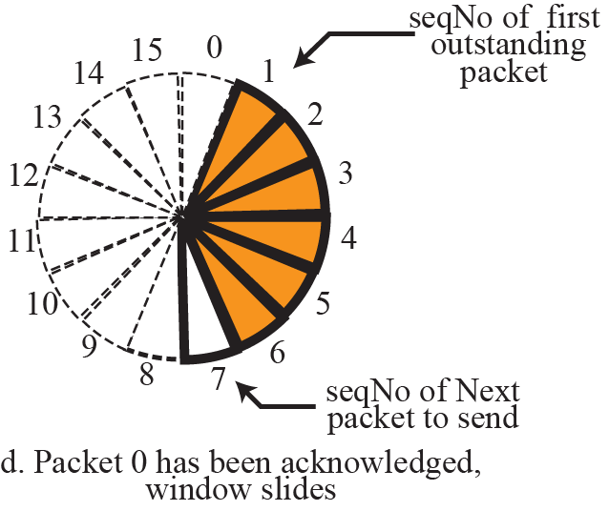
Figure 13.11 Sliding window in circular format

Slide 22
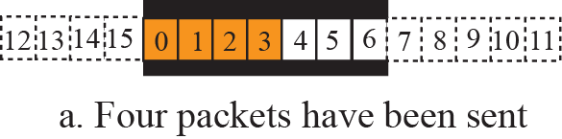
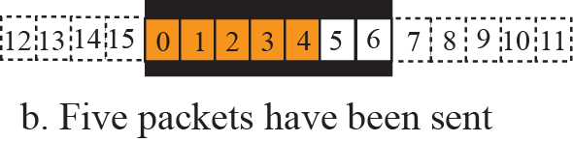
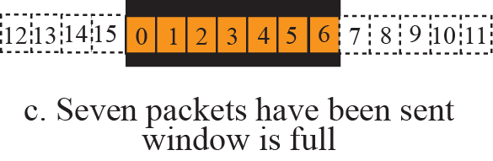
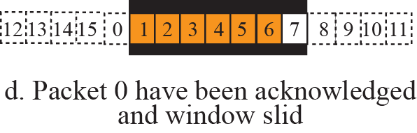
Figure 13.12 Sliding window in linear format

Slide 23
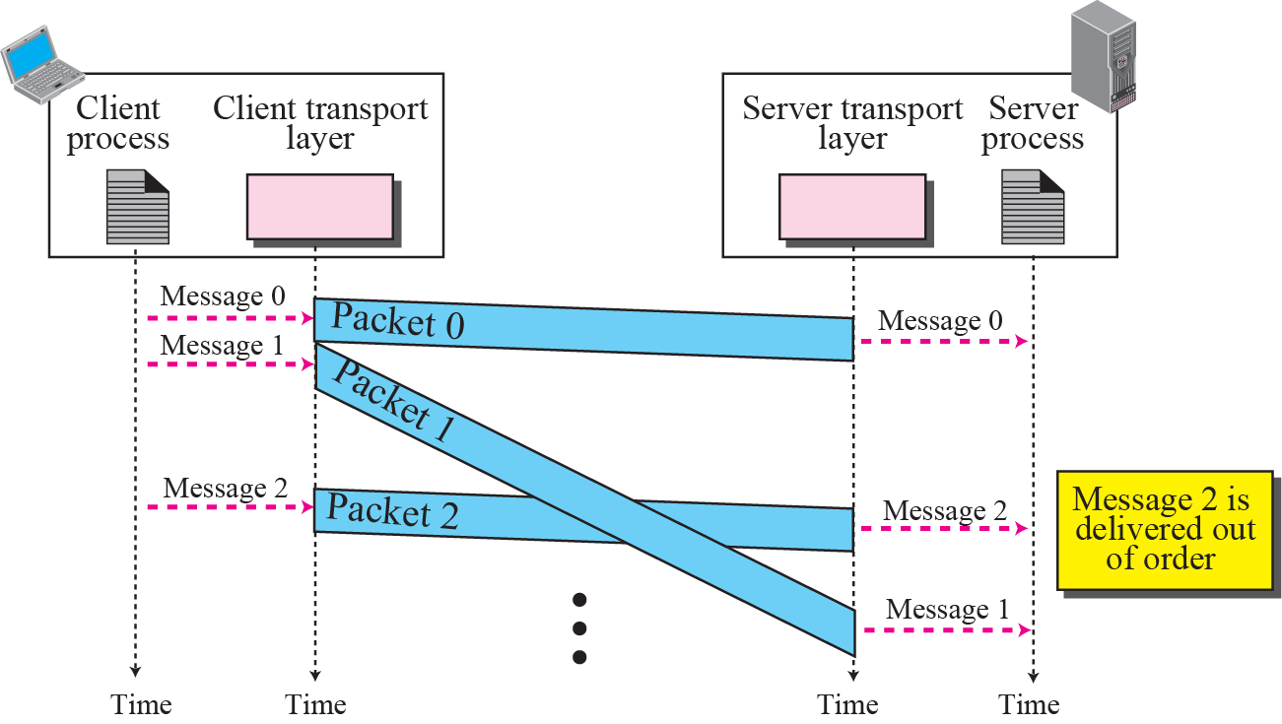
Figure 13.13 Connectionless service

Slide 24
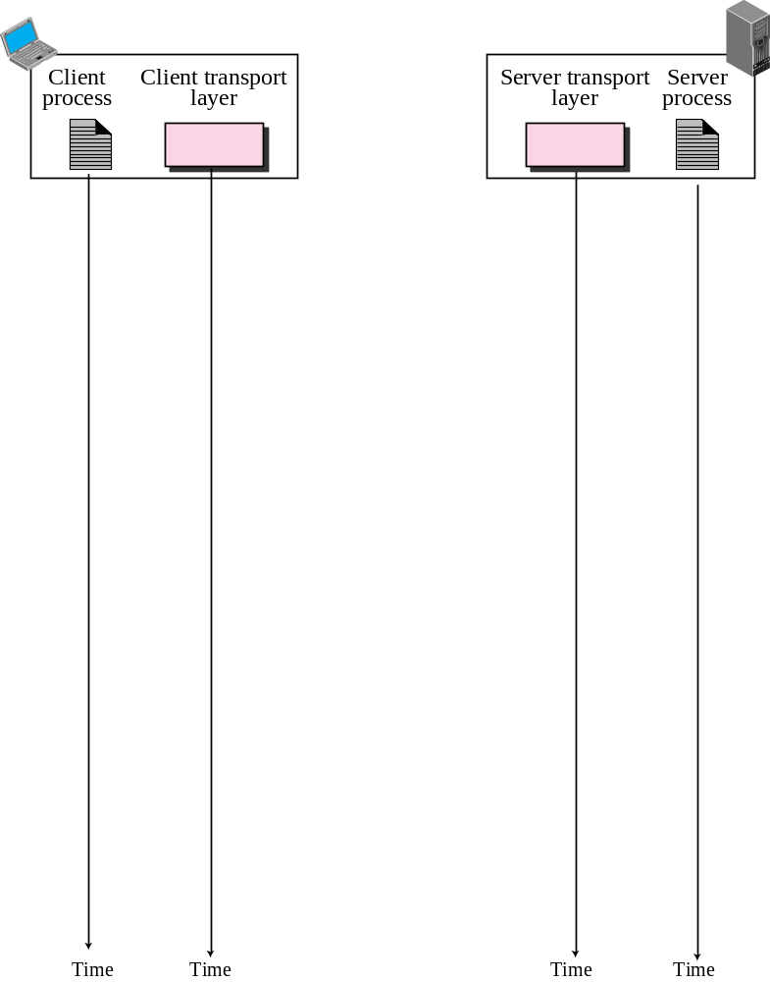
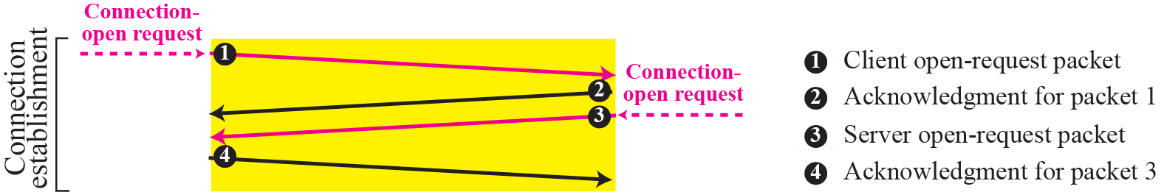
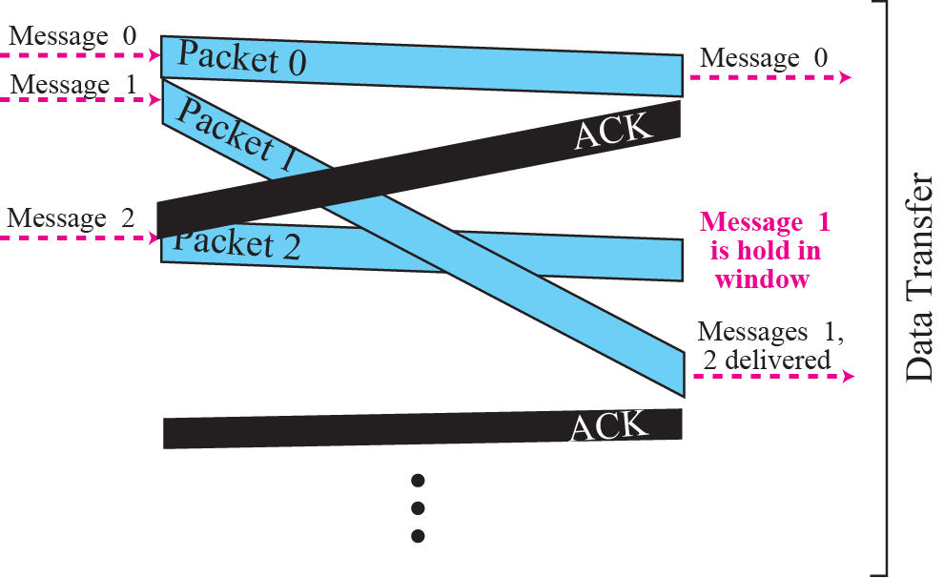
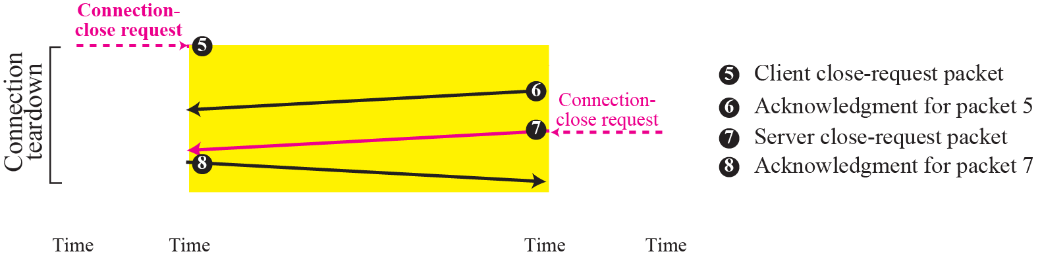
Figure 13.14 Connection-oriented service

Slide 25
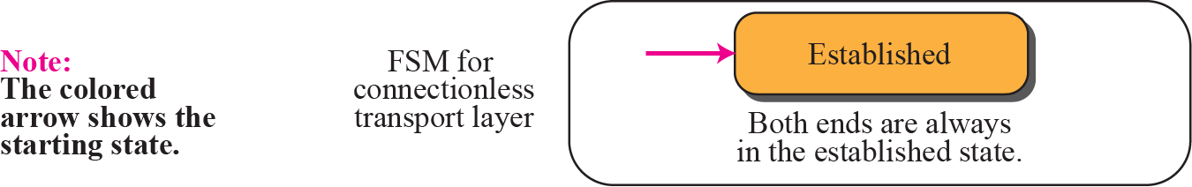
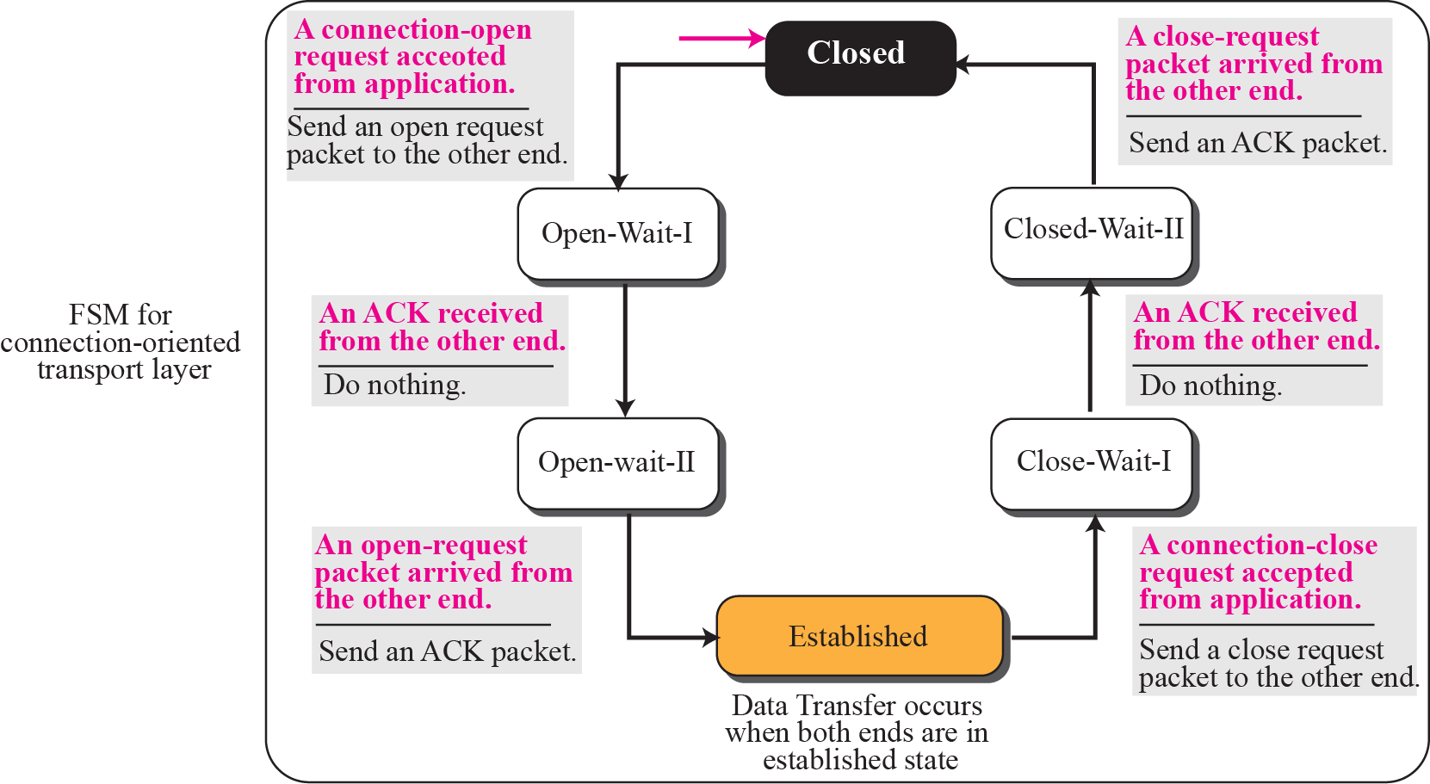
Figure 13.15 Connectionless and connection-oriented services as FSMs

Slide 26
13-2 TRANSPORT-LAYER PROTOCOLS
We can create a transport-layer protocol by combining a set of services described in the previous sections. To better understand the behavior of these protocols, we start with the simplest one and gradually add more complexity. The TCP/IP protocol uses a transport layer protocol that is either a modification or a combination of some of these protocols.

Slide 27
Topics Discussed in the Section
Simple Protocol
Stop-and-Wait Protocol
Go-Back-N Protocol
Selective-Repeat Protocol
Bidirectional Protocols: Piggybacking

Slide 28
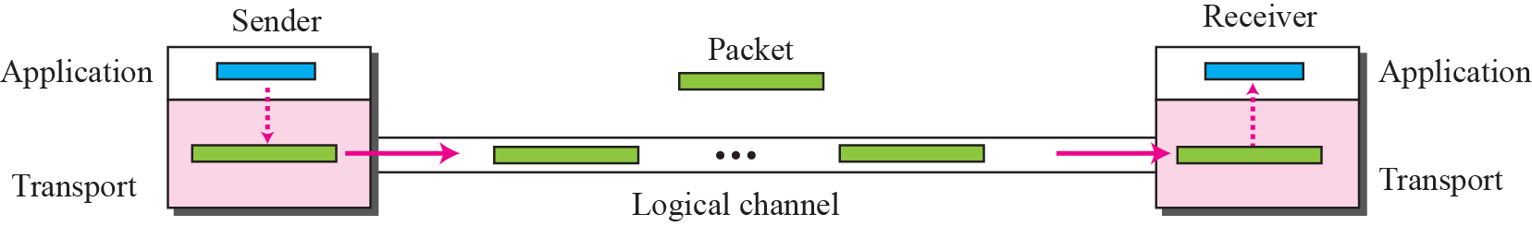
Figure 13.16 Simple protocol

Slide 29
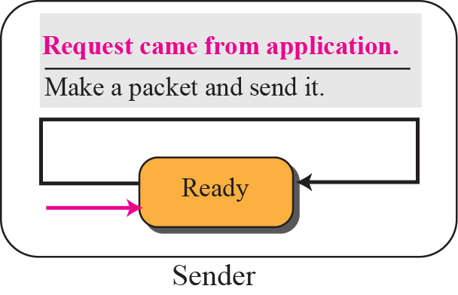
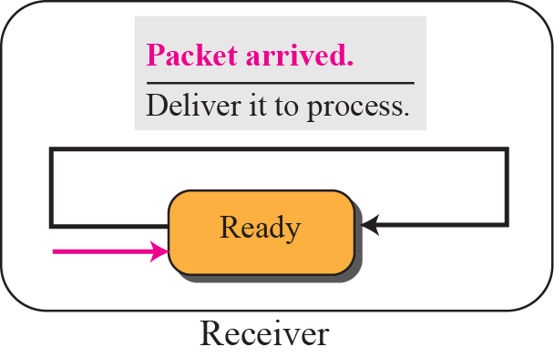
Figure 13.17 FSMs for simple protocol

Slide 30
Note
The simple protocol is a connectionless protocol that provides neither
flow nor error control.

Slide 31
Example 13.3
Figure 13.18 shows an example of communication using this protocol. It is very simple. The sender sends packets one after another without even thinking about the receiver.

Slide 32
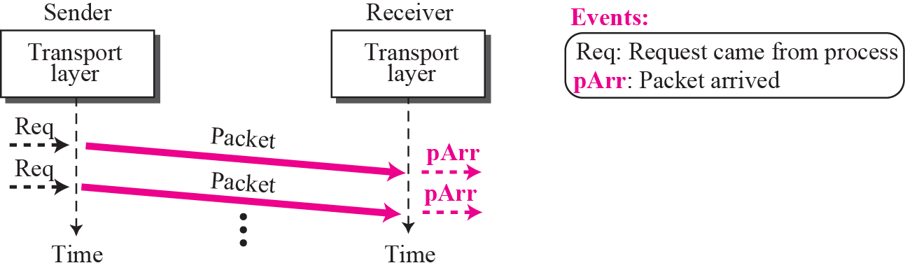
Figure 13.18 Example 13.3

Slide 33
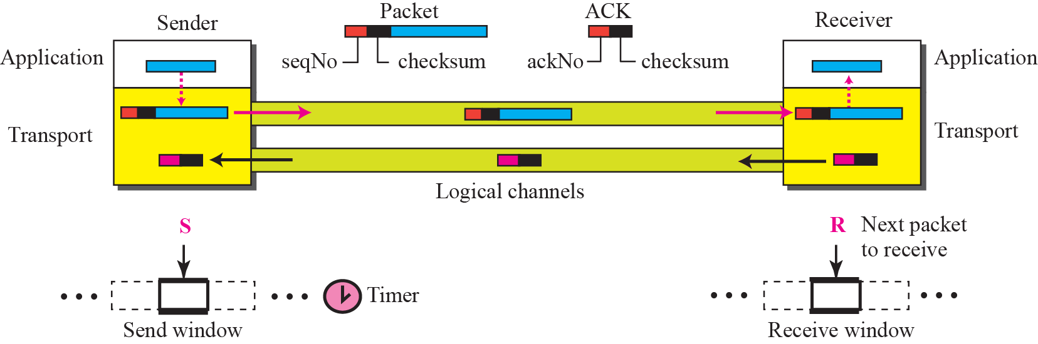
Figure 13.19 Stop-and-wait protocol

Slide 34
Note
In Stop-and-Wait protocol, flow
control is achieved by forcing the sender to wait for an acknowledgment, and error control is achieved by discarding corrupted packets and letting the sender resend unacknowledged packets when the timer expires.

Slide 35
Note
In the Stop-and-Wait protocol, we can use a 1-bit field to number the packets. The sequence numbers are based on modulo-2 arithmetic.

Slide 36
Note
In the Stop-and-Wait protocol, the acknowledgment number always announces in modulo-2 arithmetic the sequence number of the next packet expected.

Slide 37
Note
All calculation in the Stop-and-Wait protocol is in modulo 2.

Slide 38
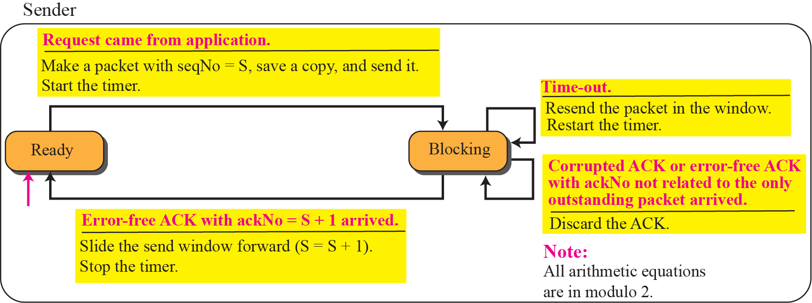
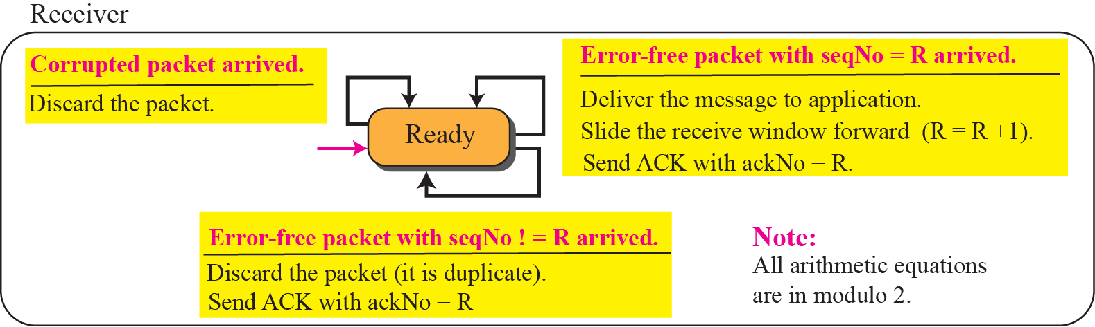
Figure 13.20 FSMs for stop-and-wait protocol

Slide 39
Example 13.4
Figure 13.21 shows an example of Stop-and-Wait protocol. Packet 0 is sent and acknowledged. Packet 1 is lost and resent after the time-out. The resent packet 1 is acknowledged and the timer stops. Packet 0 is sent and acknowledged, but the acknowledgment is lost. The sender has no idea if the packet or the acknowledgment is lost, so after the time-out, it resends packet 0, which is acknowledged.

Slide 40
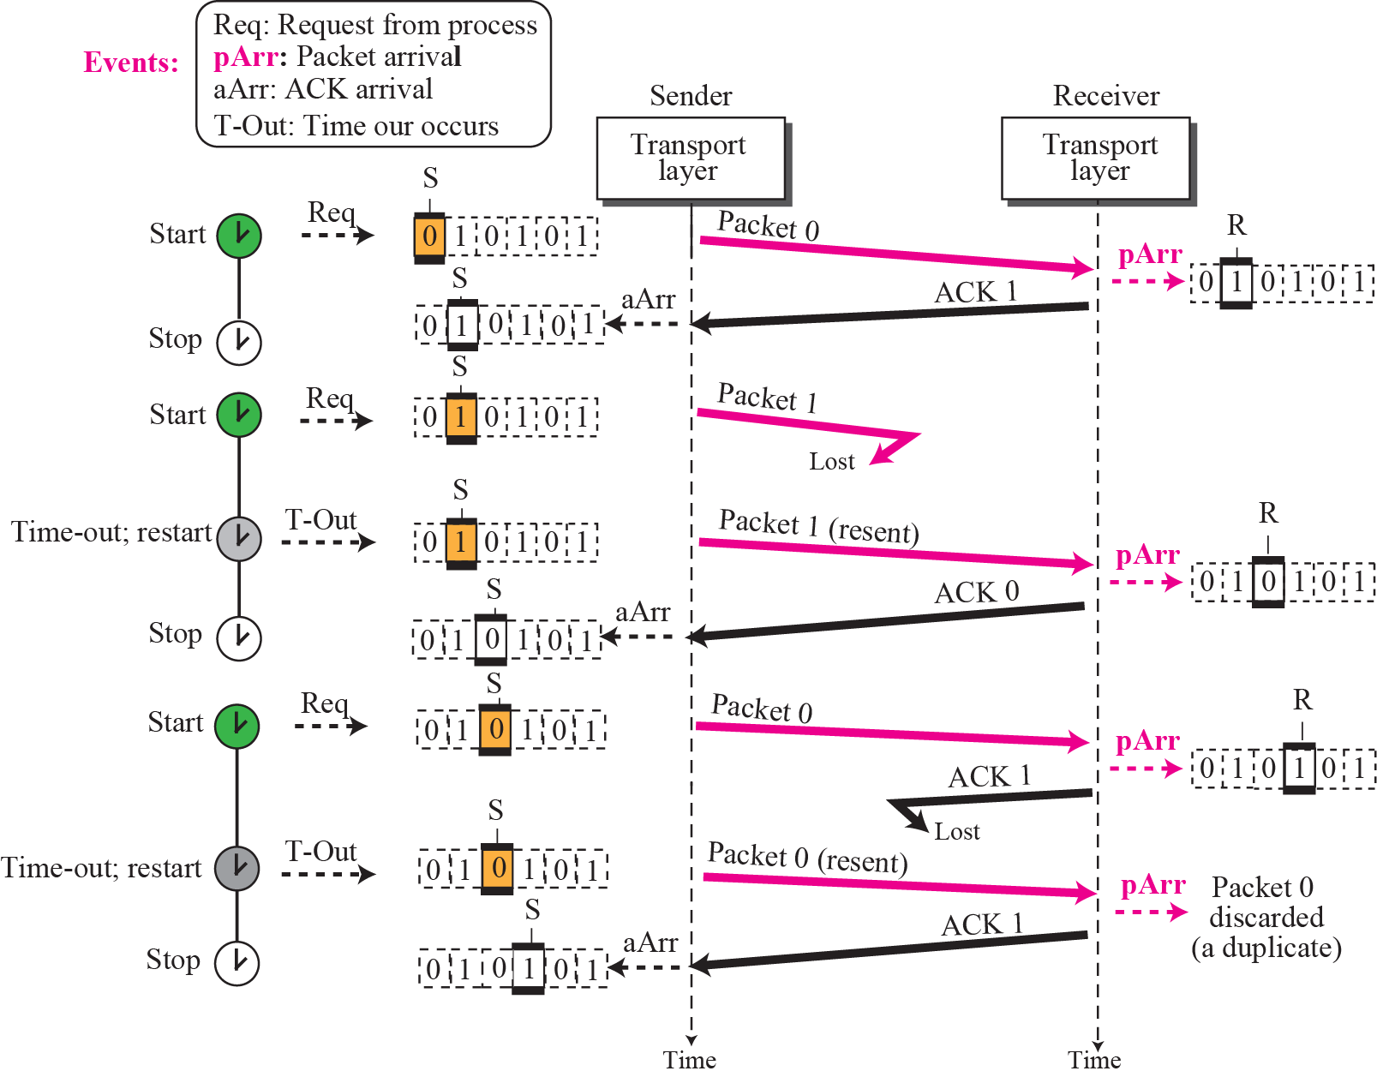
Figure 13.21 Example 13.4

Slide 41
Example 13.5
Assume that, in a Stop-and-Wait system, the bandwidth of the line is 1 Mbps, and 1 bit takes 20 milliseconds to make a round trip. What is the bandwidth-delay product? If the system data packets are 1,000 bits in length, what is the utilization percentage of the link?
Solution
The bandwidth-delay product is (1 × 10⁶) × (20 × 10⁻³) = 20,000 bits. The system can send 20,000 bits during the time it takes for the data to go from the sender to the receiver and the acknowledgment to come back. However, the system sends only 1,000 bits. We can say that the link utilization is only 1,000/20,000, or 5 percent. For this reason, for a link with a high bandwidth or long delay, the use of Stop-and-Wait wastes the capacity of the link.

Slide 42
Example 13.6
What is the utilization percentage of the link in Example 13.5 if we have a protocol that can send up to 15 packets before stopping and worrying about the acknowledgments?
Solution
The bandwidth-delay product is still 20,000 bits. The system can send up to 15 packets or 15,000 bits during a round trip. This means the utilization is 15,000/20,000, or 75 percent. Of course, if there are damaged packets, the utilization percentage is much less because packets have to be resent.

Slide 43
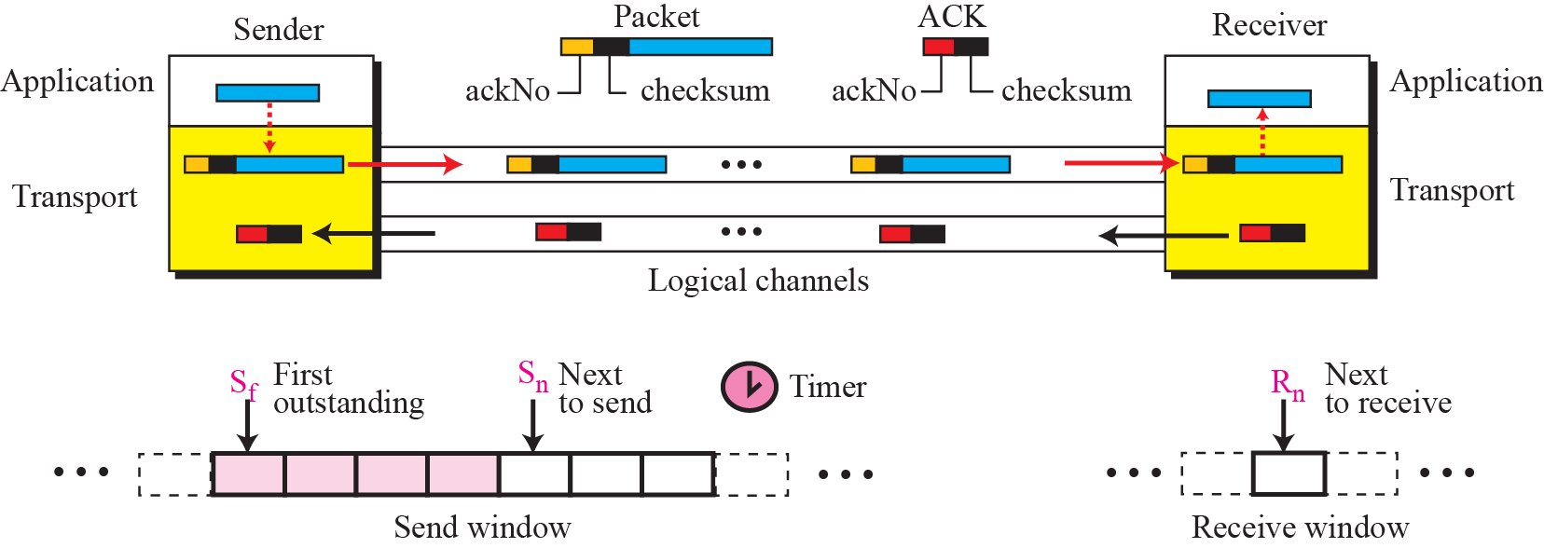
Figure 13.22 Go-Back-N protocol

Slide 44
Note
In the Go-Back-N Protocol, the sequence numbers are modulo 2^{m}, where m is the size of the sequence number
field in bits.

Slide 45
Note
In the Go-Back-N protocol, the acknowledgment number is
cumulative and defines the sequence number of the next packet
expected to arrive.

Slide 46
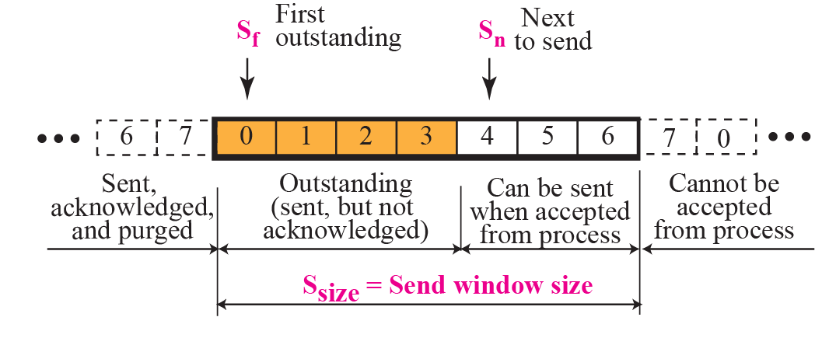
Figure 13.23 Send window for Go-Back-N

Slide 47
Note
The send window is an abstract concept defining an imaginary box of maximum
size = 2^{m} − 1 with three variables:
S_{f}, S_{n}, and S_{size}.

Slide 48
Note
The send window can slide one or
more slots when an error-free ACK
with ackNo between S_{f} and S_{n}
(in modular arithmetic) arrives.

Slide 49
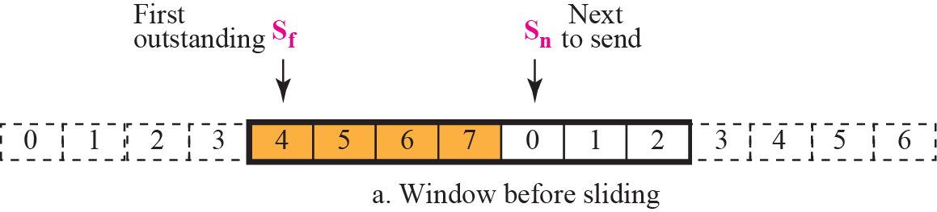
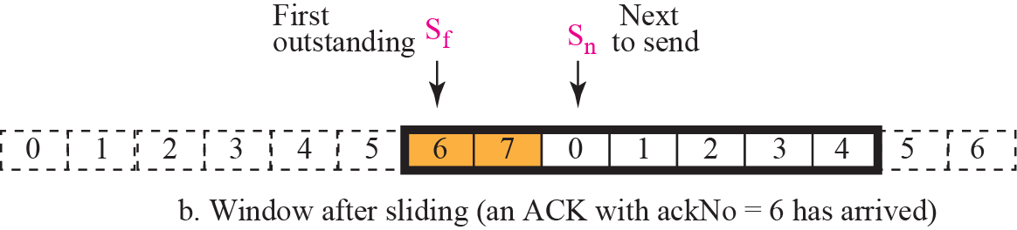
Figure 13.24 Sliding the send window

Slide 50
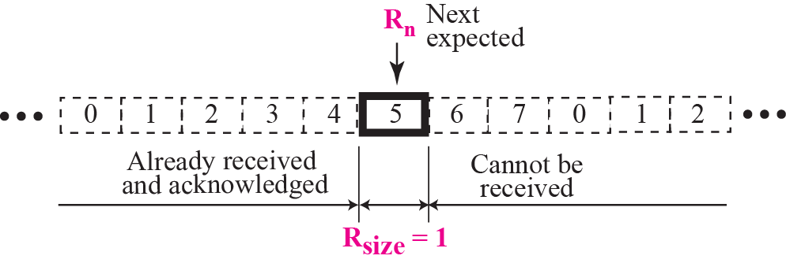
Figure 13.25 Receive window for Go-Back-N

Slide 51
Note
The receive window is an abstract concept defining an imaginary
box of size 1 with
one single variable R_{n}.
The window slides when a correct packet has arrived; sliding
occurs one slot at a time.

Slide 52
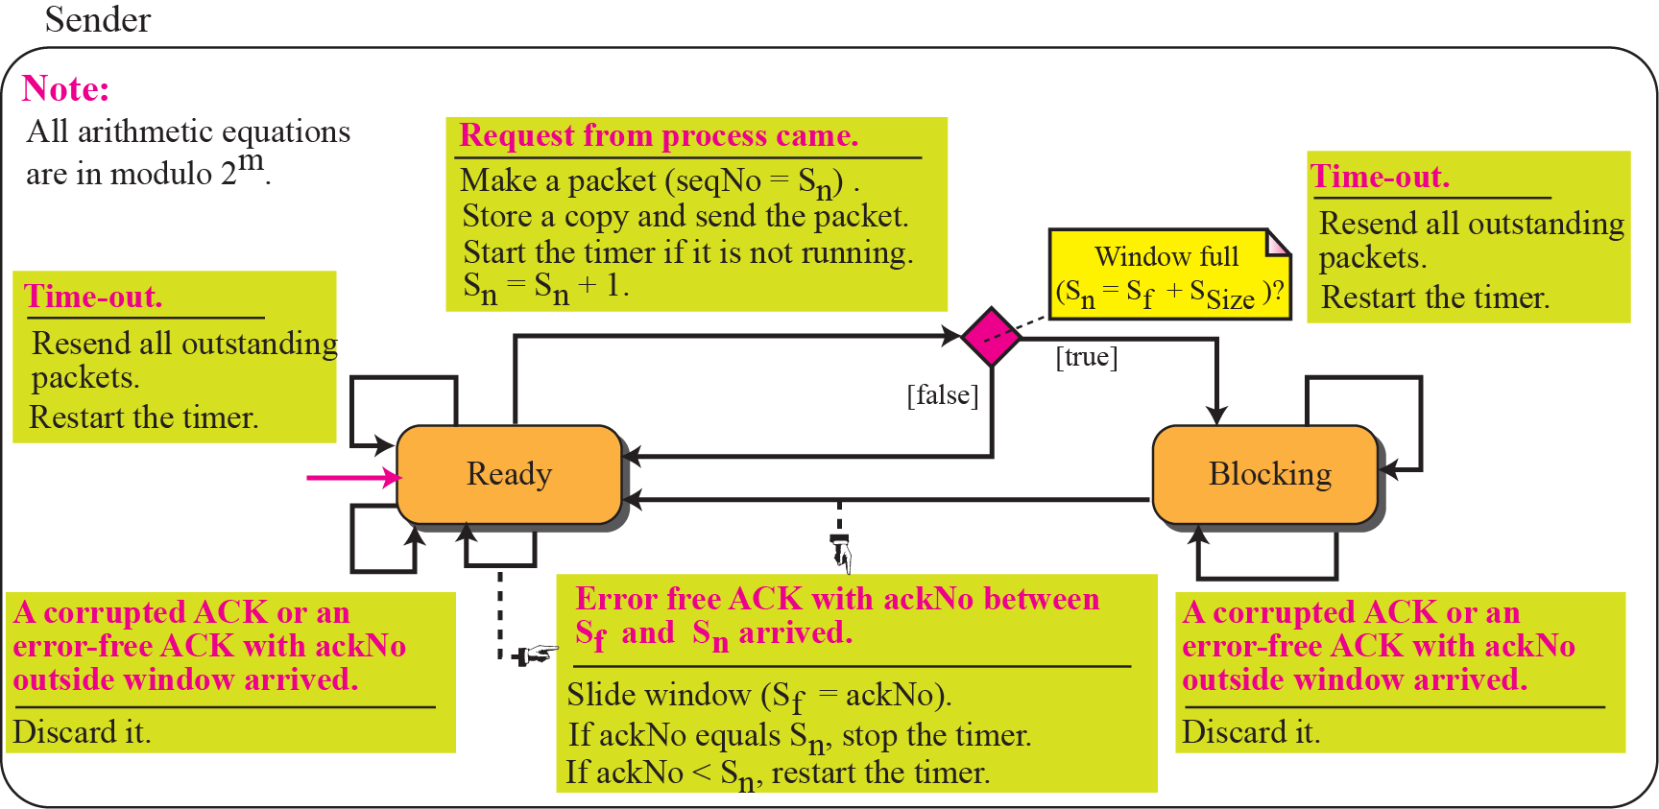
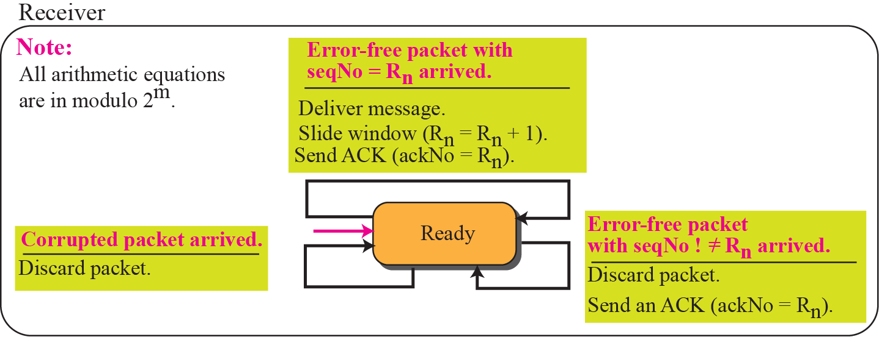
Figure 13.26 FSMs for Go-Back-N

Slide 53
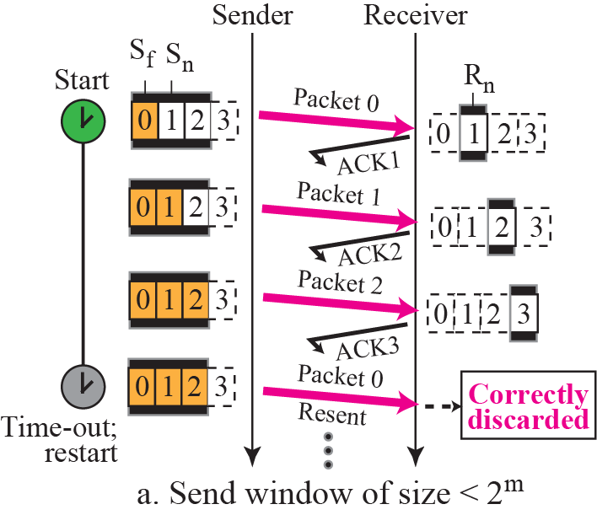
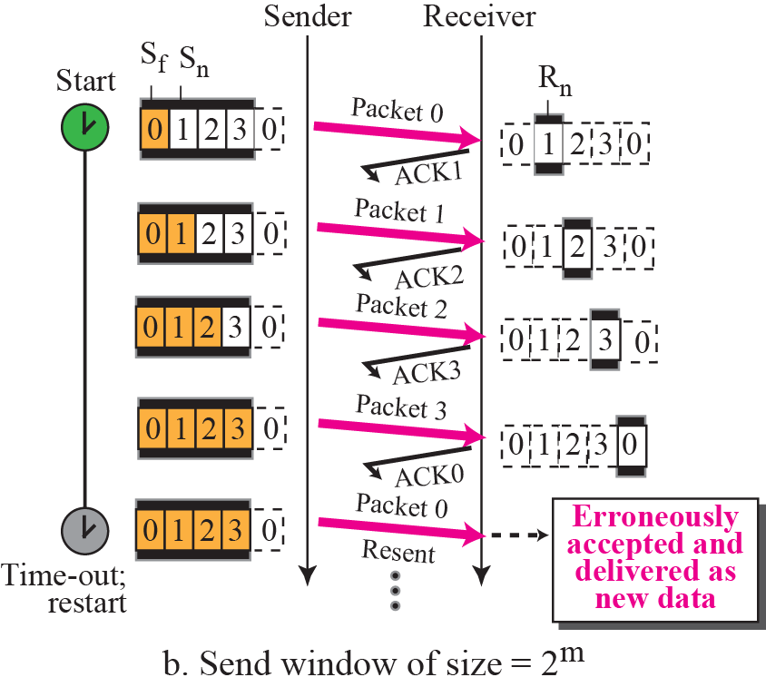
Figure 13.27 Send window size for Go-Back-N

Slide 54
Note
In the Go-Back-N protocol, the size of the send window must be less than 2m;
the size of the receive window
is always 1.

Slide 55
Example 13.7
Figure 13.28 shows an example of Go-Back-N. This is an example of a case where the forward channel is reliable, but the reverse is not. No data packets are lost, but some ACKs are delayed and one is lost. The example also shows how cumulative acknowledgments can help if acknowledgments are delayed or lost.

Slide 56

Figure 13.28 Example 13.7

Slide 57
Example 13.8
Figure 13.29 shows what happens when a packet is lost. Packets 0, 1, 2, and 3 are sent. However, packet 1 is lost. The receiver receives packets 2 and 3, but they are discarded because they are received out of order (packet 1 is expected). When the receiver receives packets 2 and 3, it sends ACK1 to show that it expects to receive packet 1. However, these ACKs are not useful for the sender because the ackNo is equal S_{f} , not greater that S_{f} . So the sender discards them. When the time-out occurs, the sender resends packets 1, 2, and 3, which are acknowledged..

Slide 58

Figure 13.29 Example 13.8

Slide 59

Figure 13.30 Outline of Selective-Repeat

Slide 60

Figure 13.31 Send window for Selective-Repeat protocol

Slide 61

Figure 13.32 Receive window for Selective-Repeat protocol

Slide 62
Note
In the Selective-Repeat protocol, an acknowledgment number defines
the sequence number of the
error-free packet received.

Slide 63
Example 13.9
Assume a sender sends 6 packets: packets 0, 1, 2, 3, 4, and 5. The sender receives an ACK with ackNo = 3. What is the interpretation if the system is using GBN or SR?
Solution
If the system is using GBN, it means that packets 0, 1, and 2 have been received uncorrupted and the receiver is expecting packet 3. If the system is using SR, it means that packet 3 has been received uncorrupted; the ACK does not say anything about other packets.

Slide 64


Figure 13.33 FSMs for SR protocol

Slide 65
Example 13.10
This example is similar to Example 3.8 (Figure 13.29) in which packet 1 is lost. We show how Selective-Repeat behaves in this case. Figure 13.34 shows the situation. At the sender, packet 0 is transmitted and acknowledged. Packet 1 is lost. Packets 2 and 3 arrive out of order and are acknowledged. When the timer times out, packet 1 (the only unacknowledged packet) is resent and is acknowledged. The send window then slides.

Slide 66

Figure 13.34 Example 13.10

Slide 67


Figure 13.35 Selective-Repeat window size

Slide 68
Note
In Selective-Repeat, the size of the sender and receiver window
can be at most one-half of 2m.

Slide 69

Figure 13.36 Design of piggybacking for Go-Back-N

